Slide 1
Programming 1 - WEEK 3
Skills

Slide 2
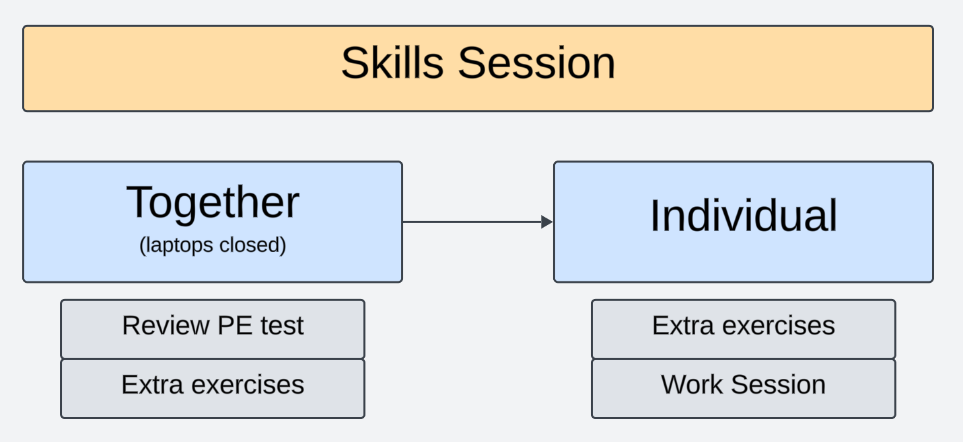
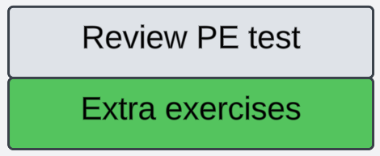
Approach

Slide 3
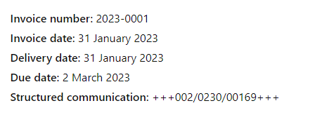
Structured Payment Reference
A structured payment reference is a unique 12-digit code added to payments, allowing them to be automatically linked to the correct invoice. The format is +++ xxx/xxxx/xxxxx +++, with the last two digits being a check digit, calculated from the first 10 digits. Entering this reference correctly (including "+++" and "/") ensures error-free and efficient processing of the payment.
We will write a program to create a valid structured payment reference based on a given invoice number.

Slide 4

Part 1
Write a function control_digit(number) that returns the control digit of number. The parameter number is a positive integer. To determine the control digit for this number, we calculate the remainder when dividing the number by 97. If the remainder is 0, the control digit is set to 97.
Example:
number = 123456789
control_digit(number) = 39

Slide 5
Part 2
Write a function make_10_digits(number). The parameter number contains a positive integer with at most 10 digits.
The return value of this function should be a text value of exactly 10 characters containing the input number with leading zero’s when necessary.
Example:
number = 123456789
make_10_digits(number)= “0123456789”

Slide 6
Part 3
Write a function add_control_digit(text). The parameter text contains a 10-digit positive integer as a text value.
The return value of this function should be a text value of 12 characters that combines the input value text with the control number calculated in part 1.
Example:
text = “0123456789”
add_control_digit(text) = “012345678939”

Slide 7
Part 4
Write a function add_symbols(text) that returns a formatted text value based on the following structure:
The resulting string should start with '+++', followed by the first 3 characters of the input text.
Then, append a '/', followed by the next 4 characters of the input text.
Add another '/', followed by the last 5 characters of the input text.
Finally, end the string with '+++’.
Example:
text = “012345678939”
add_symbols(text) = “+++012/3456/78939+++”

Slide 8
Part 5
Write a function create_reference(number) that returns a structured payment reference based on the given number.
Example:
number = 123456789
create_payment_reference(number) = “+++012/3456/78939+++”

